Slide 1
Proposed
Aberdeen Activity Center
Community Meeting
March 10, 2022

Slide 2
Agenda
Review Previous Community Responses to Survey – Priorities Established
Program Development - Benchmarking
Chenowith Activity Center
McFaul Activity Center
Havre de Grace Activity Center
Initial Spatial Program
Site Plan Evaluation
Setbacks
Environmental – Streams
Environmental – Wetlands
Right-Of-Way
SHA Access Permit
Site Possibilities
Next Steps
Questions
Community Meeting March 10, 2022

Slide 3
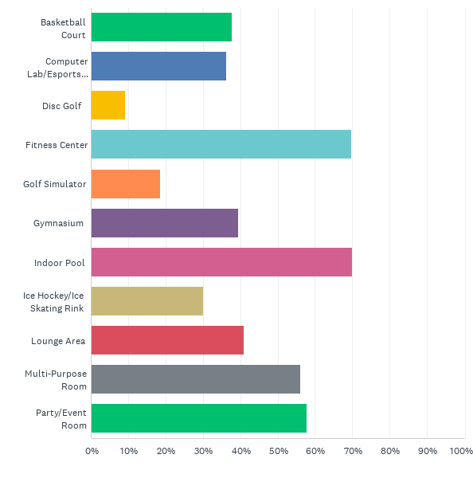
Community Survey Results – Indoor Amenities
Priorities
#1 – Fitness Center
#2 – Indoor Pool
#3 - Multipurpose Room
#4 – Event Room
#5 – Commons/Lounge
#6 – Gymnasium
#7 – E-Sports/Gaming
#8 – Computer Room
From Community Survey November 2, 2021
Community Meeting March 10, 2022

Slide 4
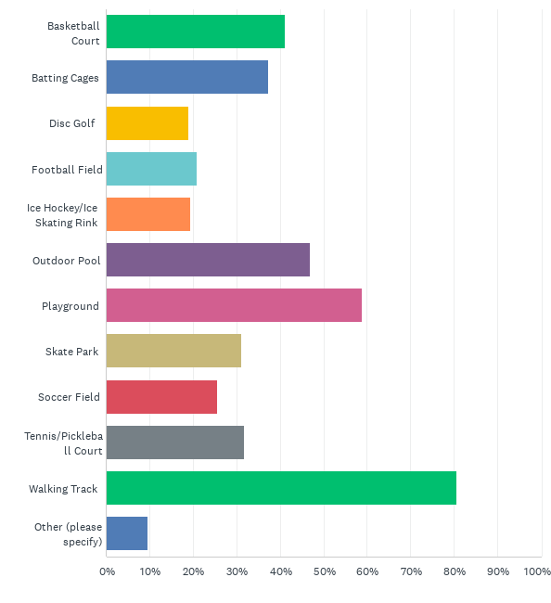
Community Survey Results – Outdoor Amenities
Priorities
#1 – Walking Track/Trail
#2 – Playground
#3 – Outdoor Pool
#4 - General Purpose Field
#5 – Disc Golf
From Community Survey November 2, 2021
Community Meeting March 10, 2022

Slide 5
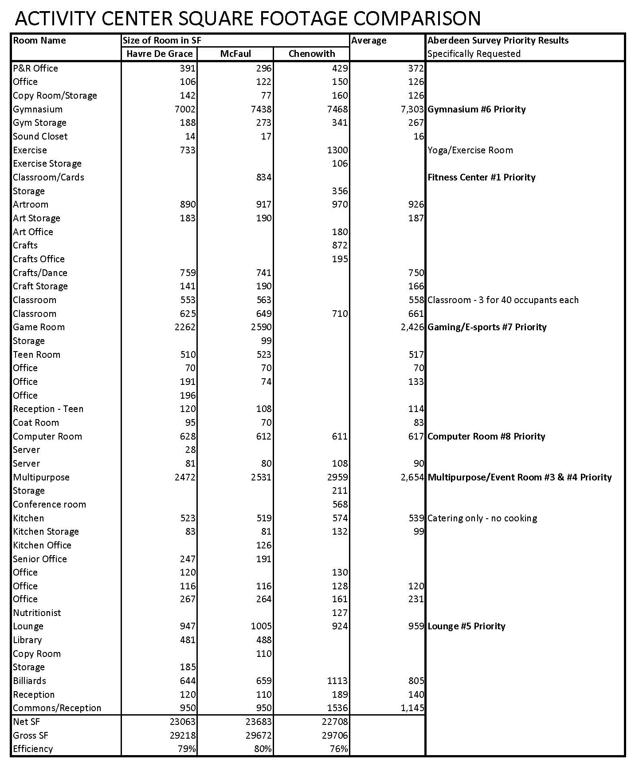
Program Development - Benchmarking
Compare 3 Existing Facilities
Havre De Grace
McFaul
Chenowith
Average Size for Each Room
Community Meeting March 10, 2022

Slide 6
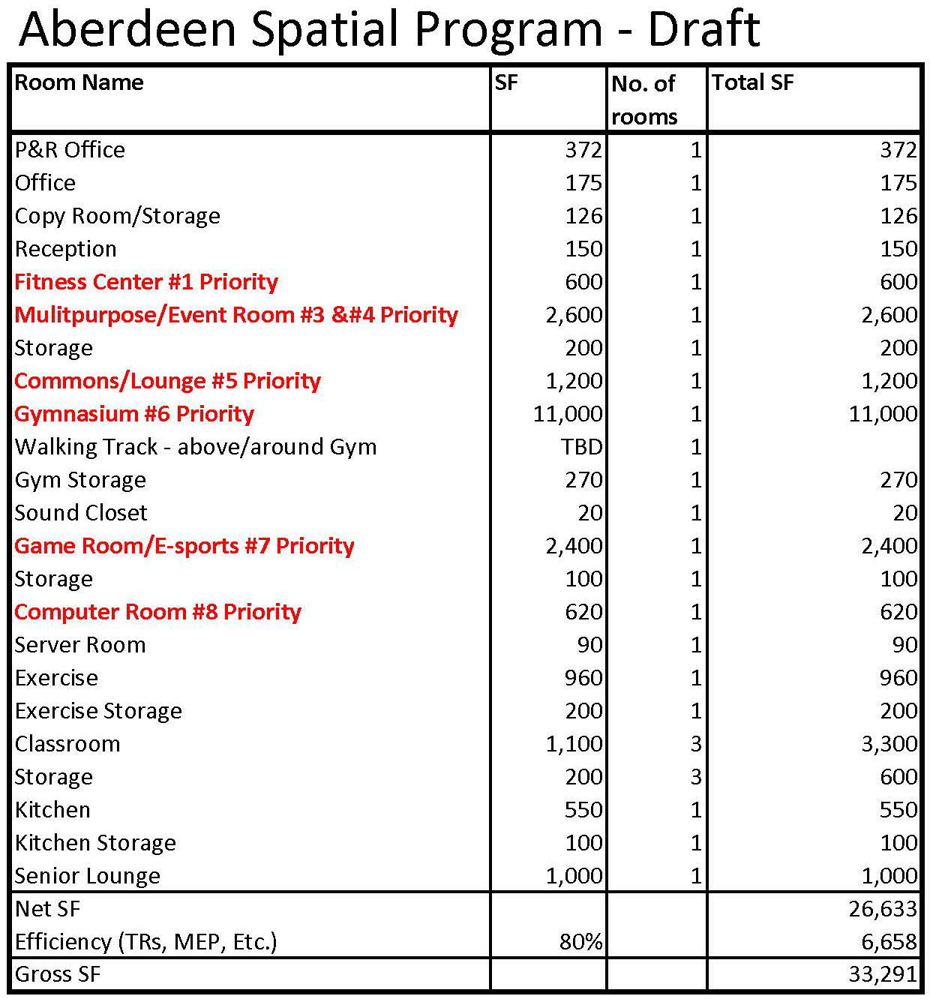
Program Development – Aberdeen Activity Center
Analysis
Target - 30,000 SF Total
Gymnasium is larger than average size
Multipurpose Room also serves as the Event Room
Community Meeting March 10, 2022

Slide 7
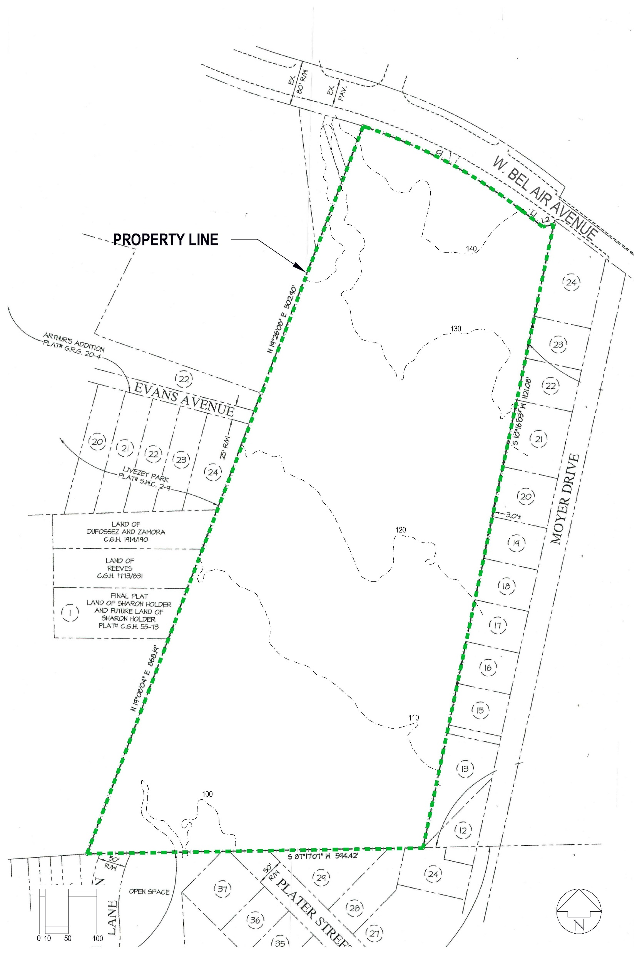
Site Evaluation
Overall Site Characteristics
13.44 Acres
Grade Drops from North to South 44 Feet (3% Slope)
Looking North Along East Property Line
Community Meeting March 10, 2022

Slide 8
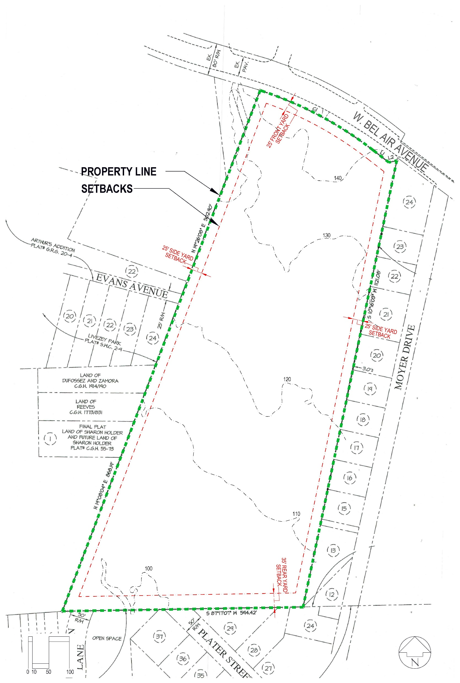
Site Evaluation
Property Setbacks
25 Feet from Front Property Line
25 Feet from Side Property Lines
35 Feet from Rear Property Line
Community Meeting March 10, 2022

Slide 9
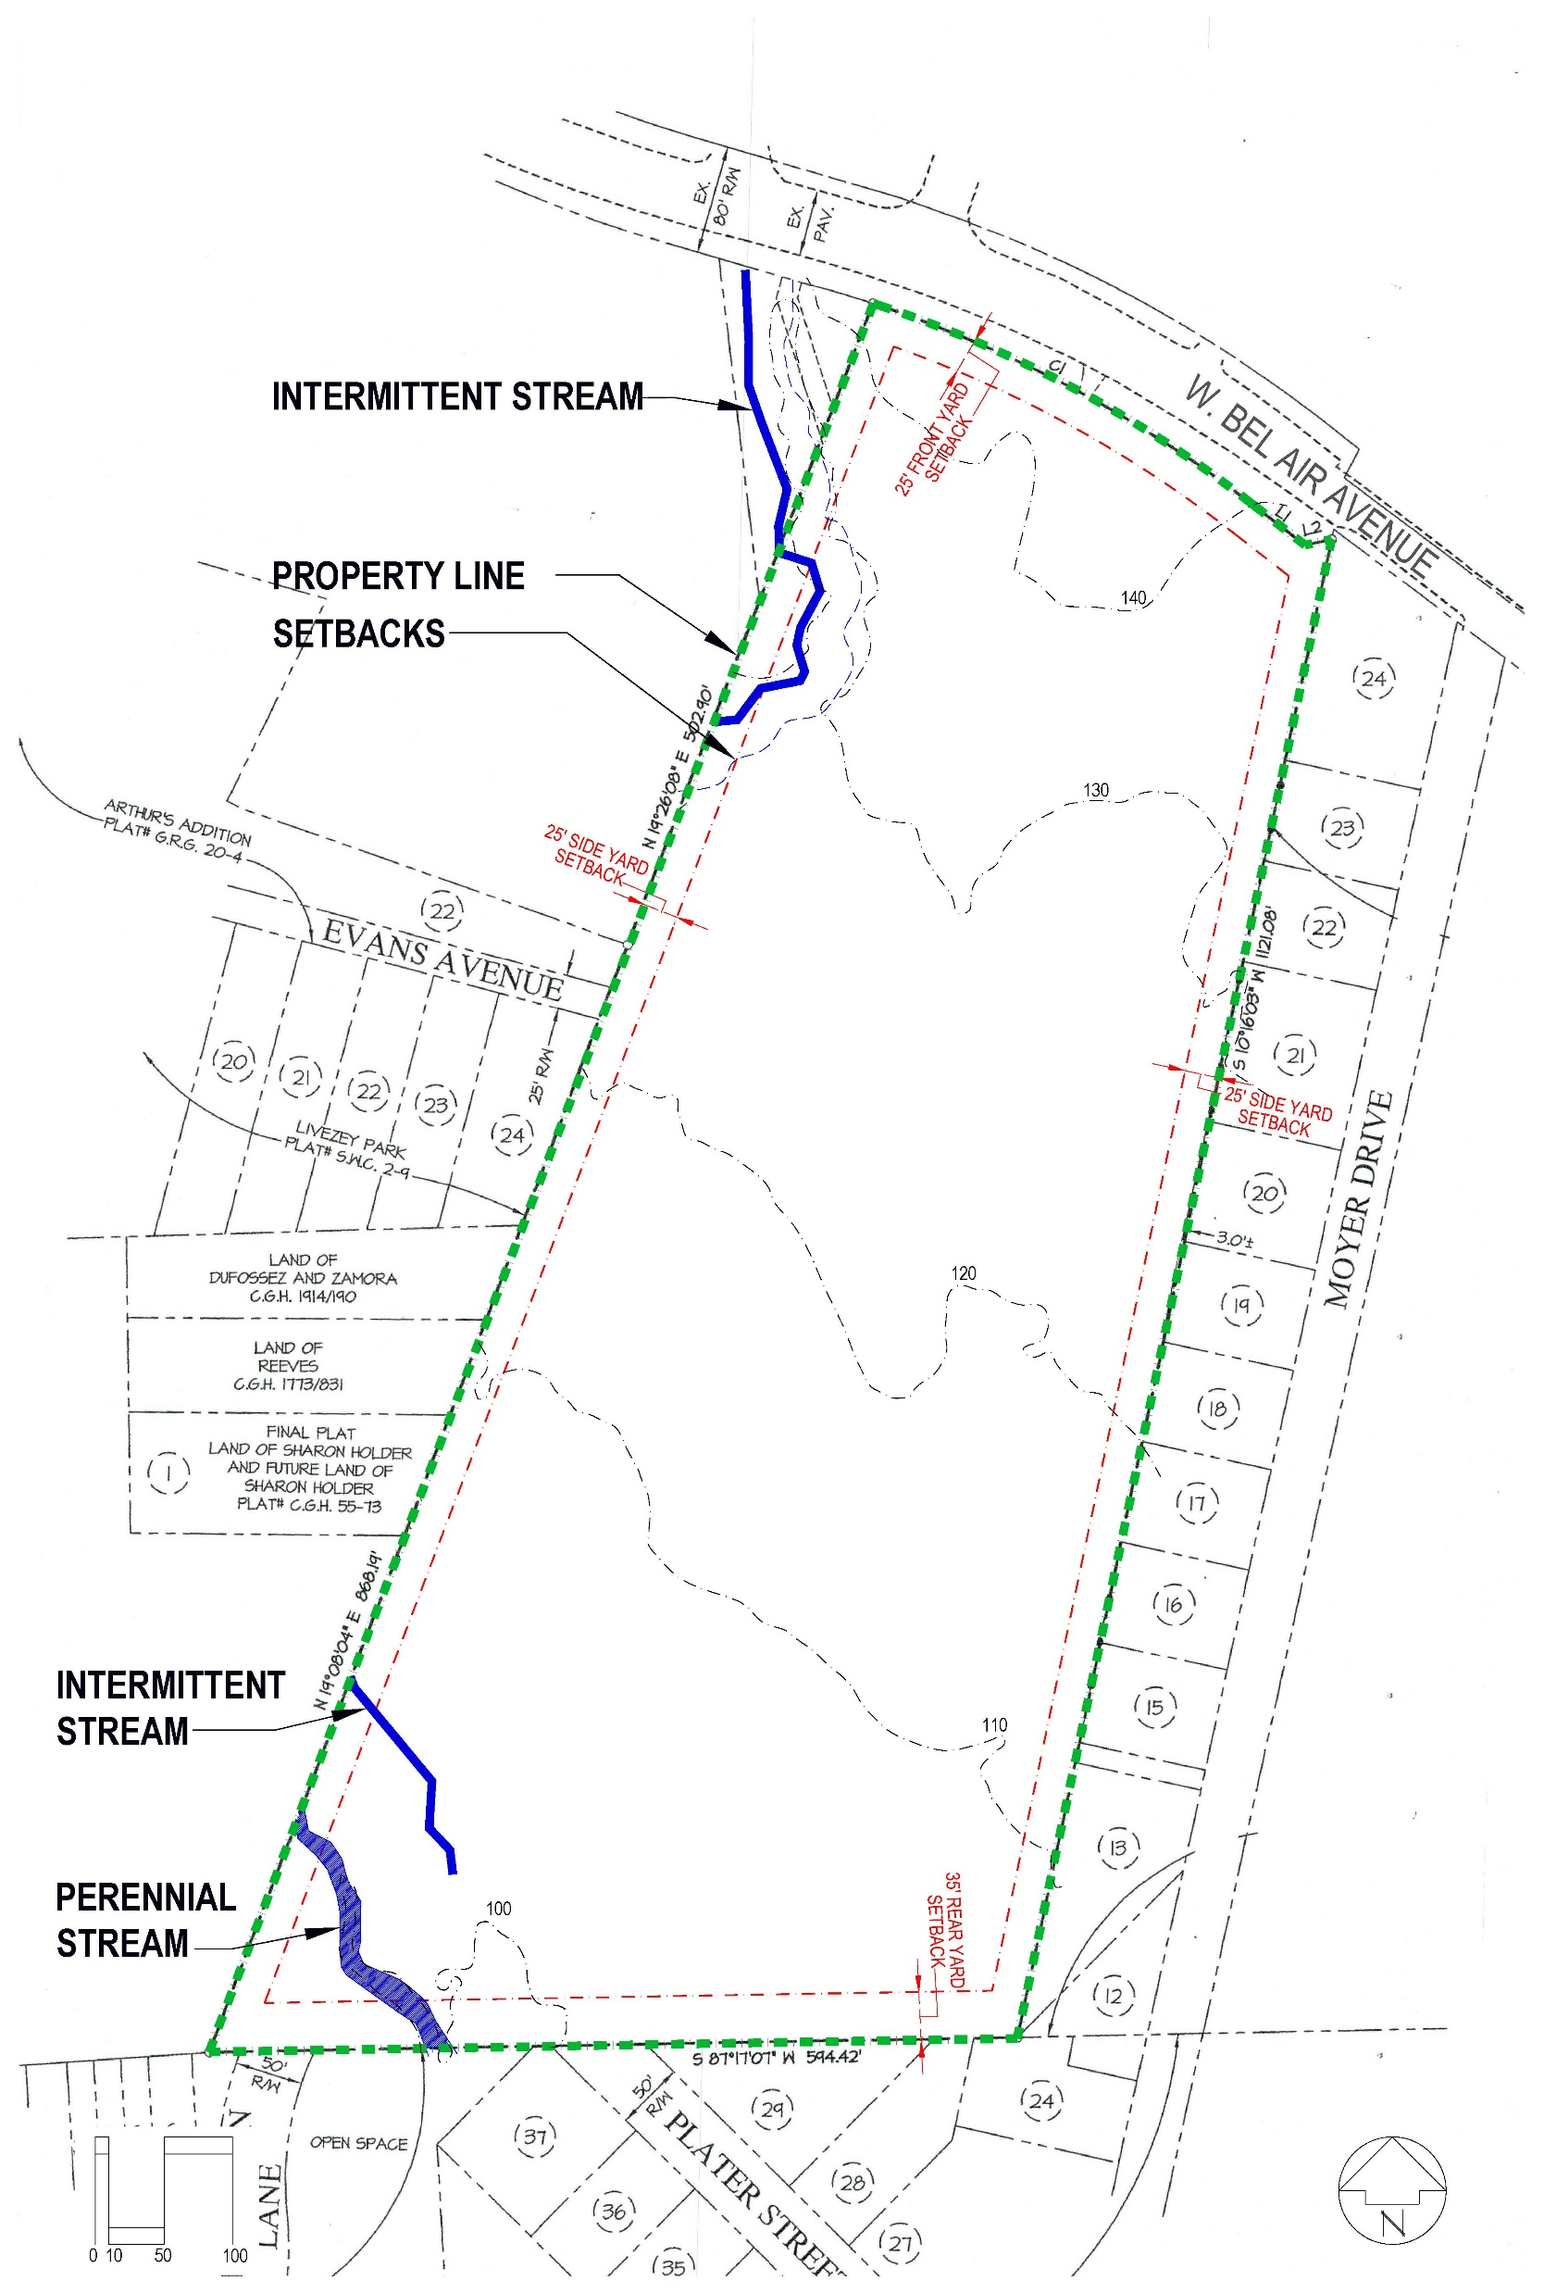
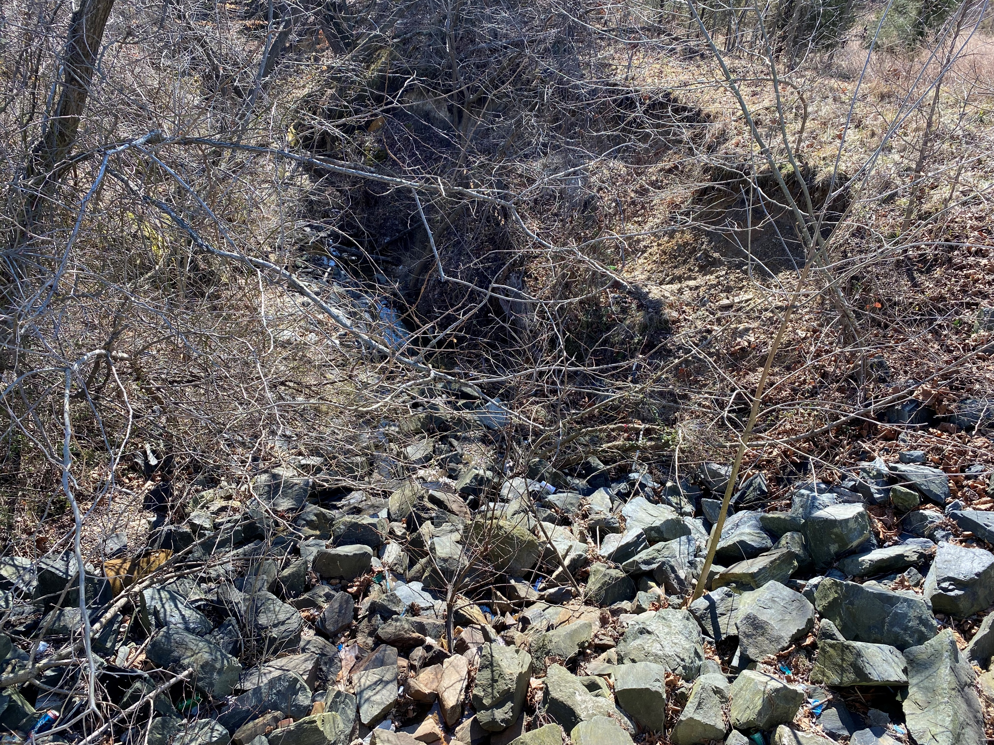
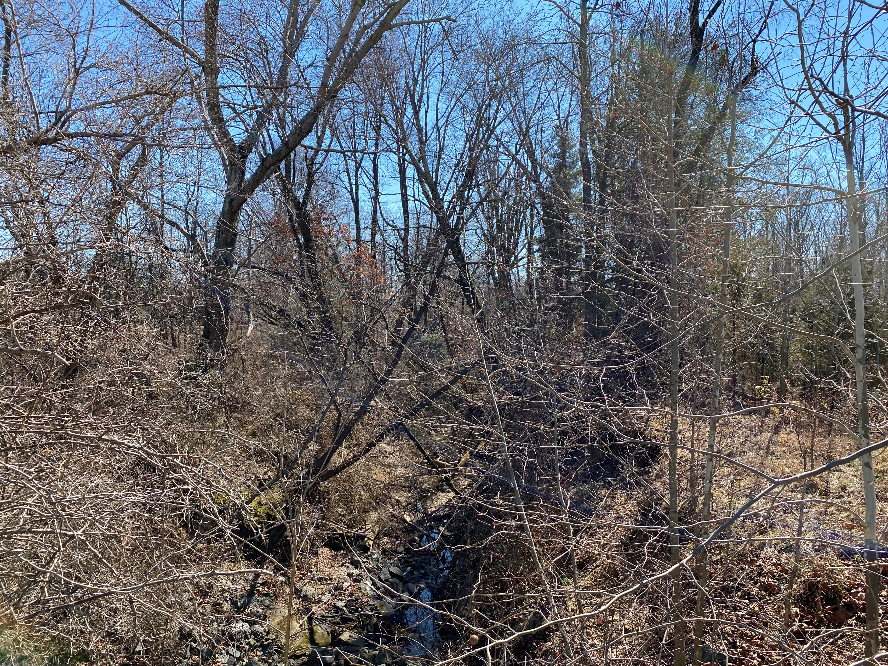
Site Evaluation Based on previous preliminary evaluation by GTA
Environmental - Streams
2 Intermittent Streams Identified
1 Perennial Stream Identified
Intermittent Stream at W. Bel Air Avenue – Looking South
Community Meeting March 10, 2022

Slide 10
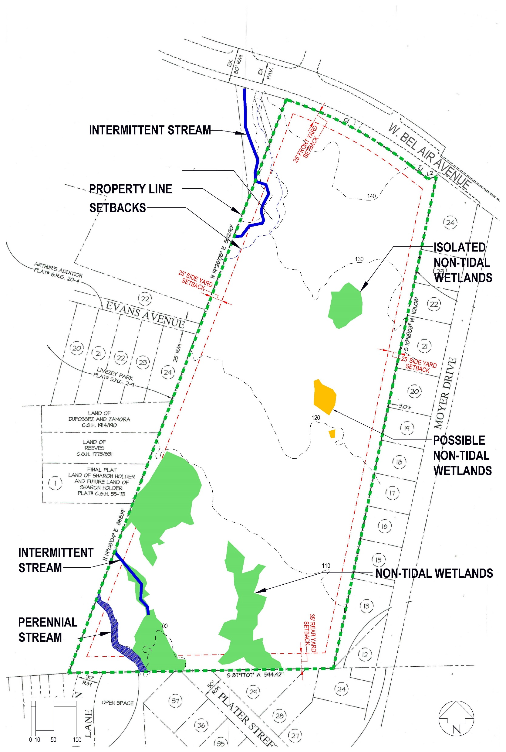
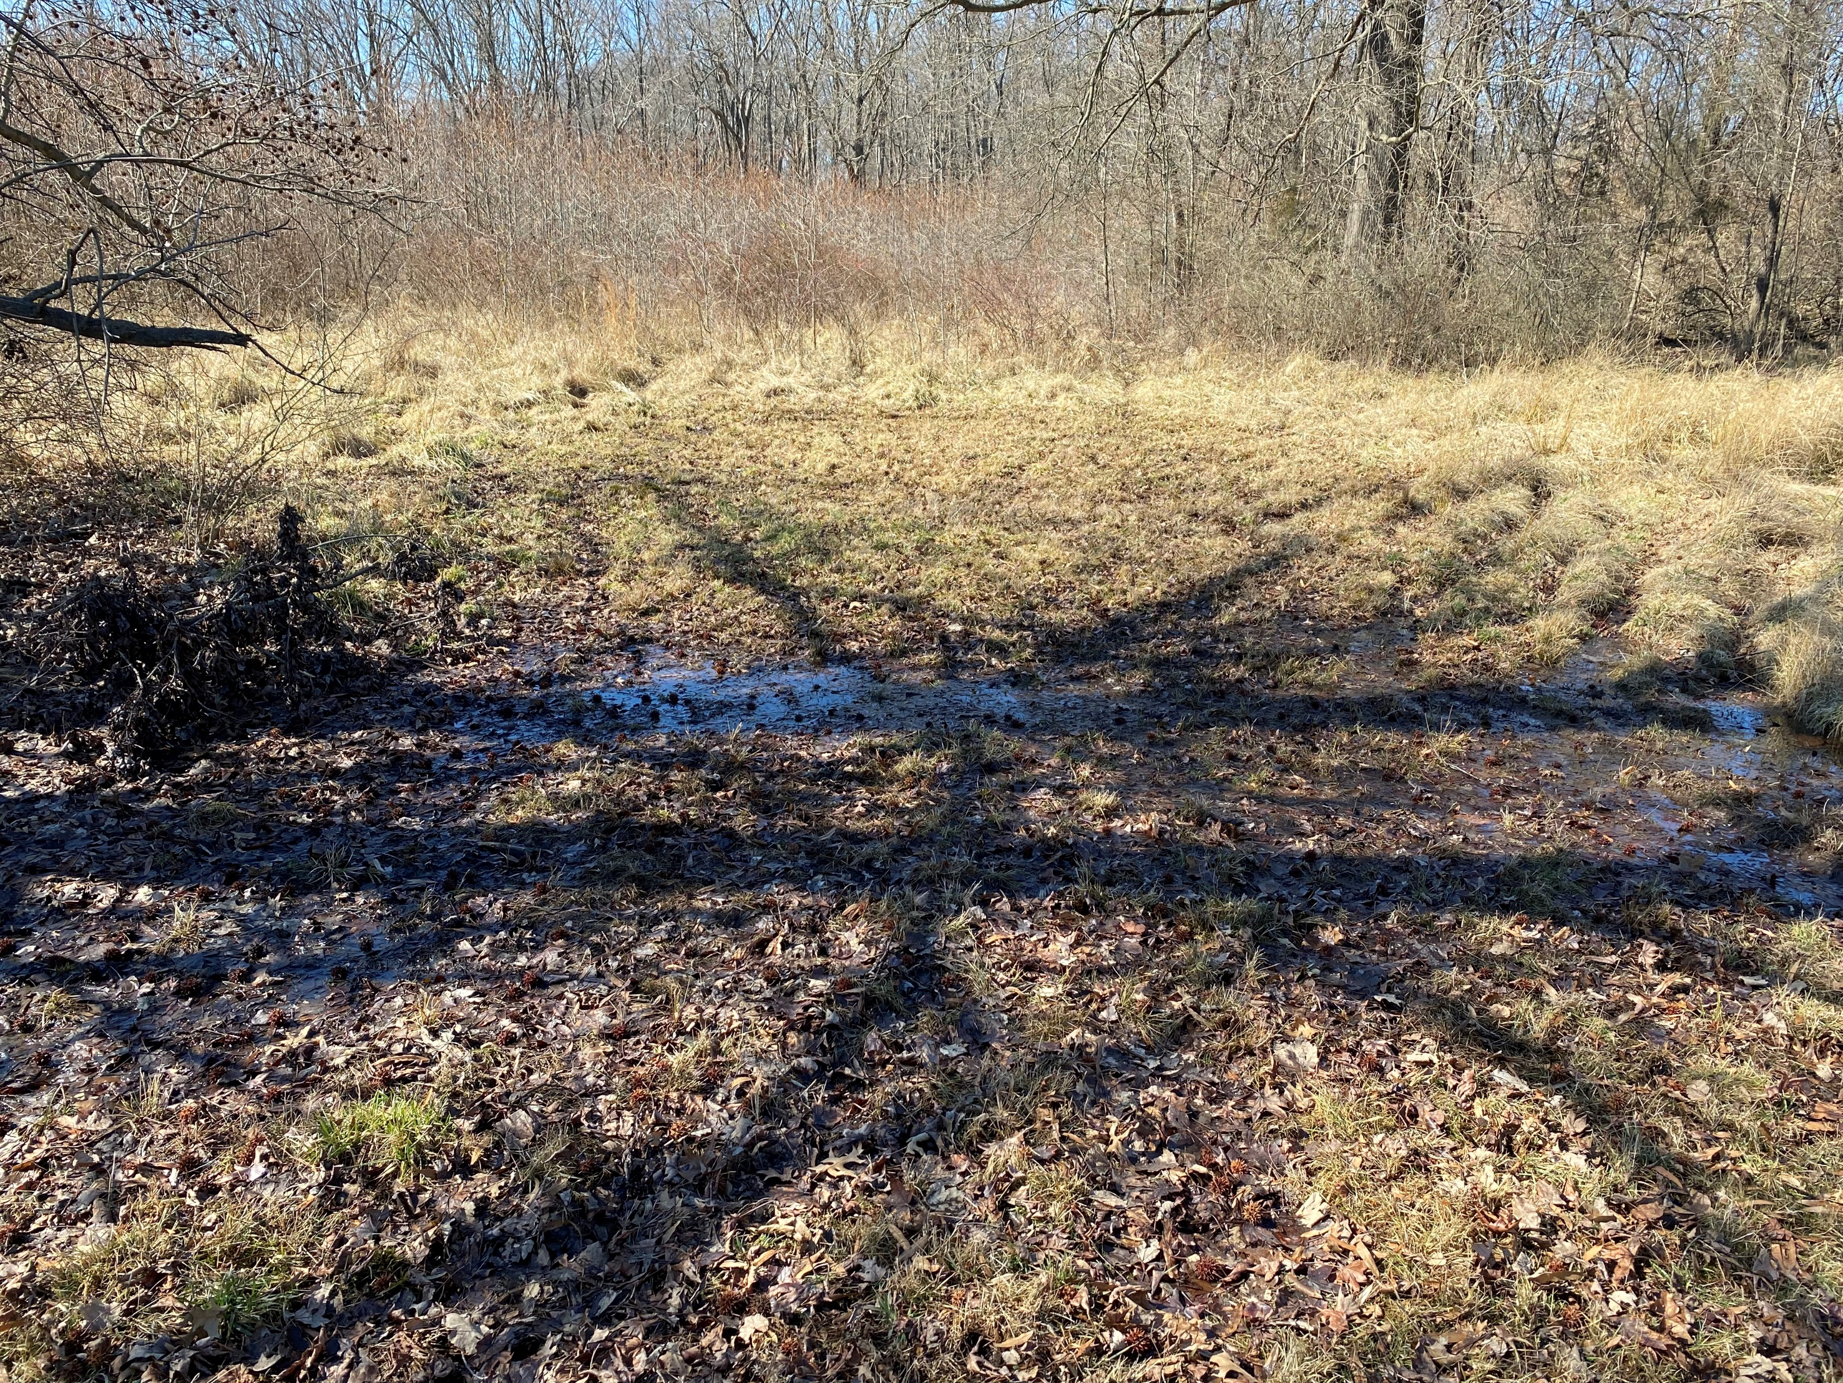
Site Evaluation Based on previous preliminary evaluation by GTA
Environmental - Wetlands
3 Non-Tidal Wetlands Identified
1 Isolated Non-Tidal Wetlands Identified
2 Possible Non-Tidal Wetlands Identified
Standing Water on Grade – Looking West
Community Meeting March 10, 2022

Slide 11
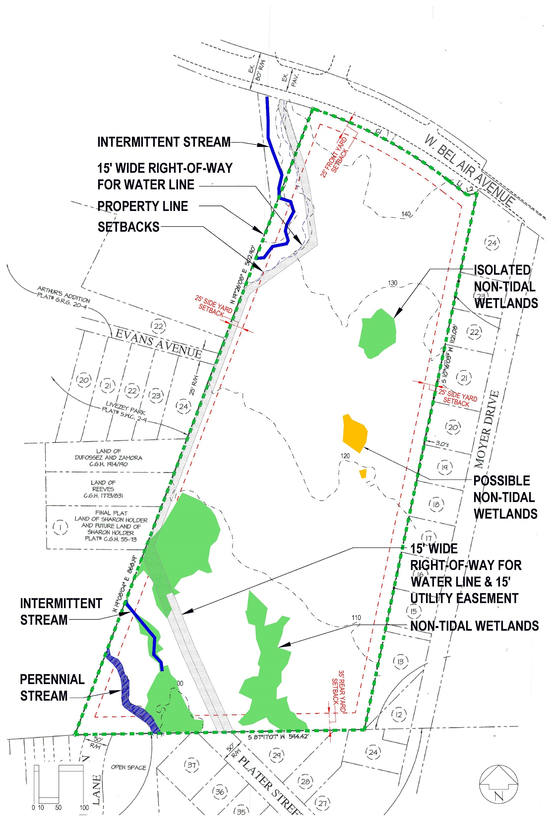
Site Evaluation Based on previous preliminary evaluation by GTA
Right-Of-Way
1 - 15 Foot R.O.W. for Water Line
1 - 15 Foot Utility Easement
Community Meeting March 10, 2022

Slide 12
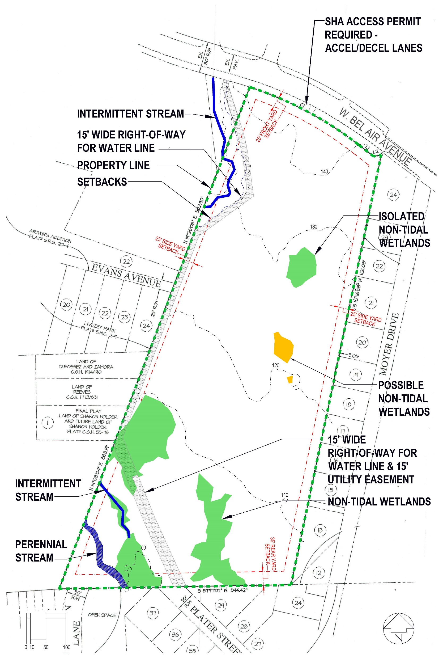
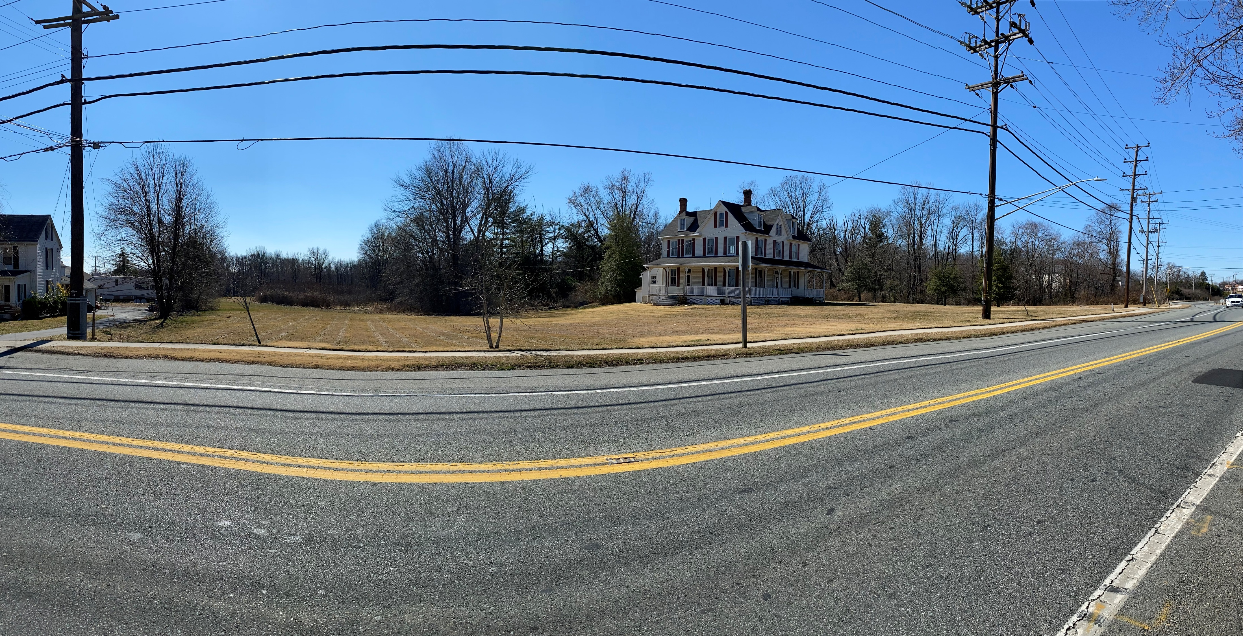
Site Evaluation
SHA Access Permit
Acceleration/Deceleration Lanes Required
Is Existing Shoulder Construction Adequate?
Will Existing Utility Poles Need to be Relocated?
Panoramic view Looking South
Community Meeting March 10, 2022

Slide 13
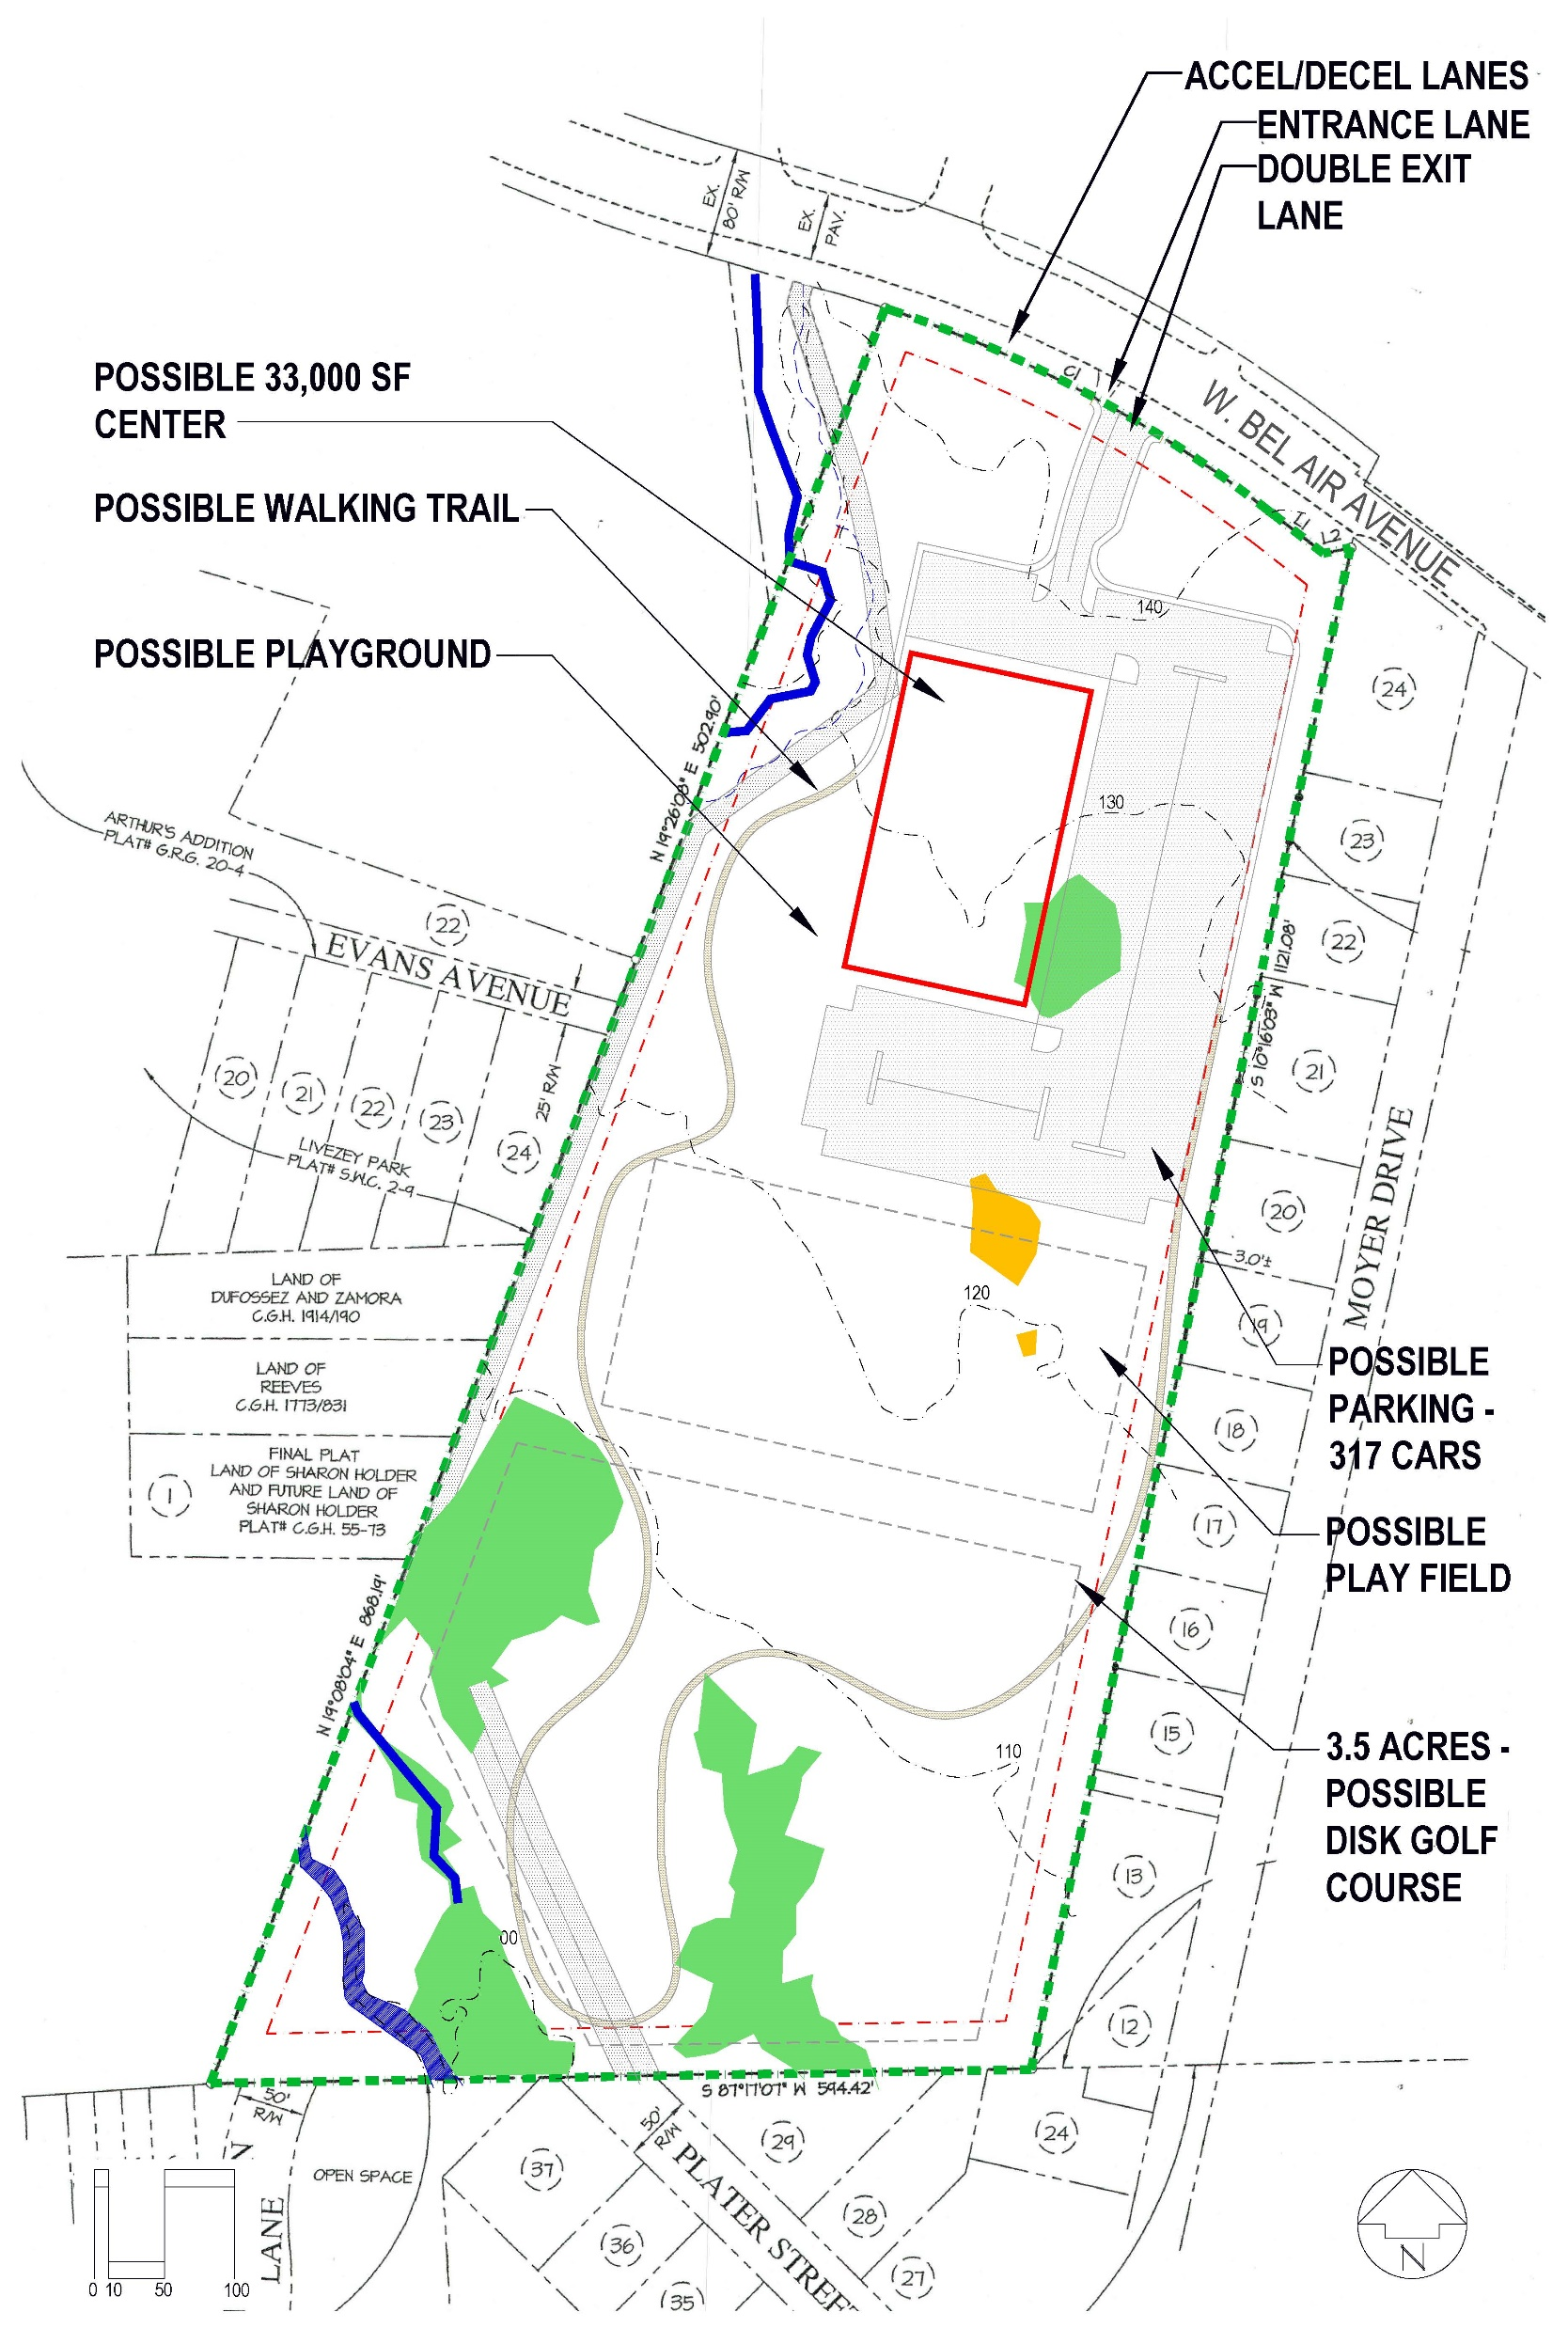
Site Possibilities
Possible Site Development
32,000 Square Foot Building
317 Parking Spaces (107 Required)
Walking Trail
All Purpose Play Field
Possible Disk Golf Course
The amenities and their locations are shown to offer a “sense of scale” of how they could fit on the site.
More will be determined once an environmental survey is undertaken.
Community Meeting March 10, 2022

Slide 14
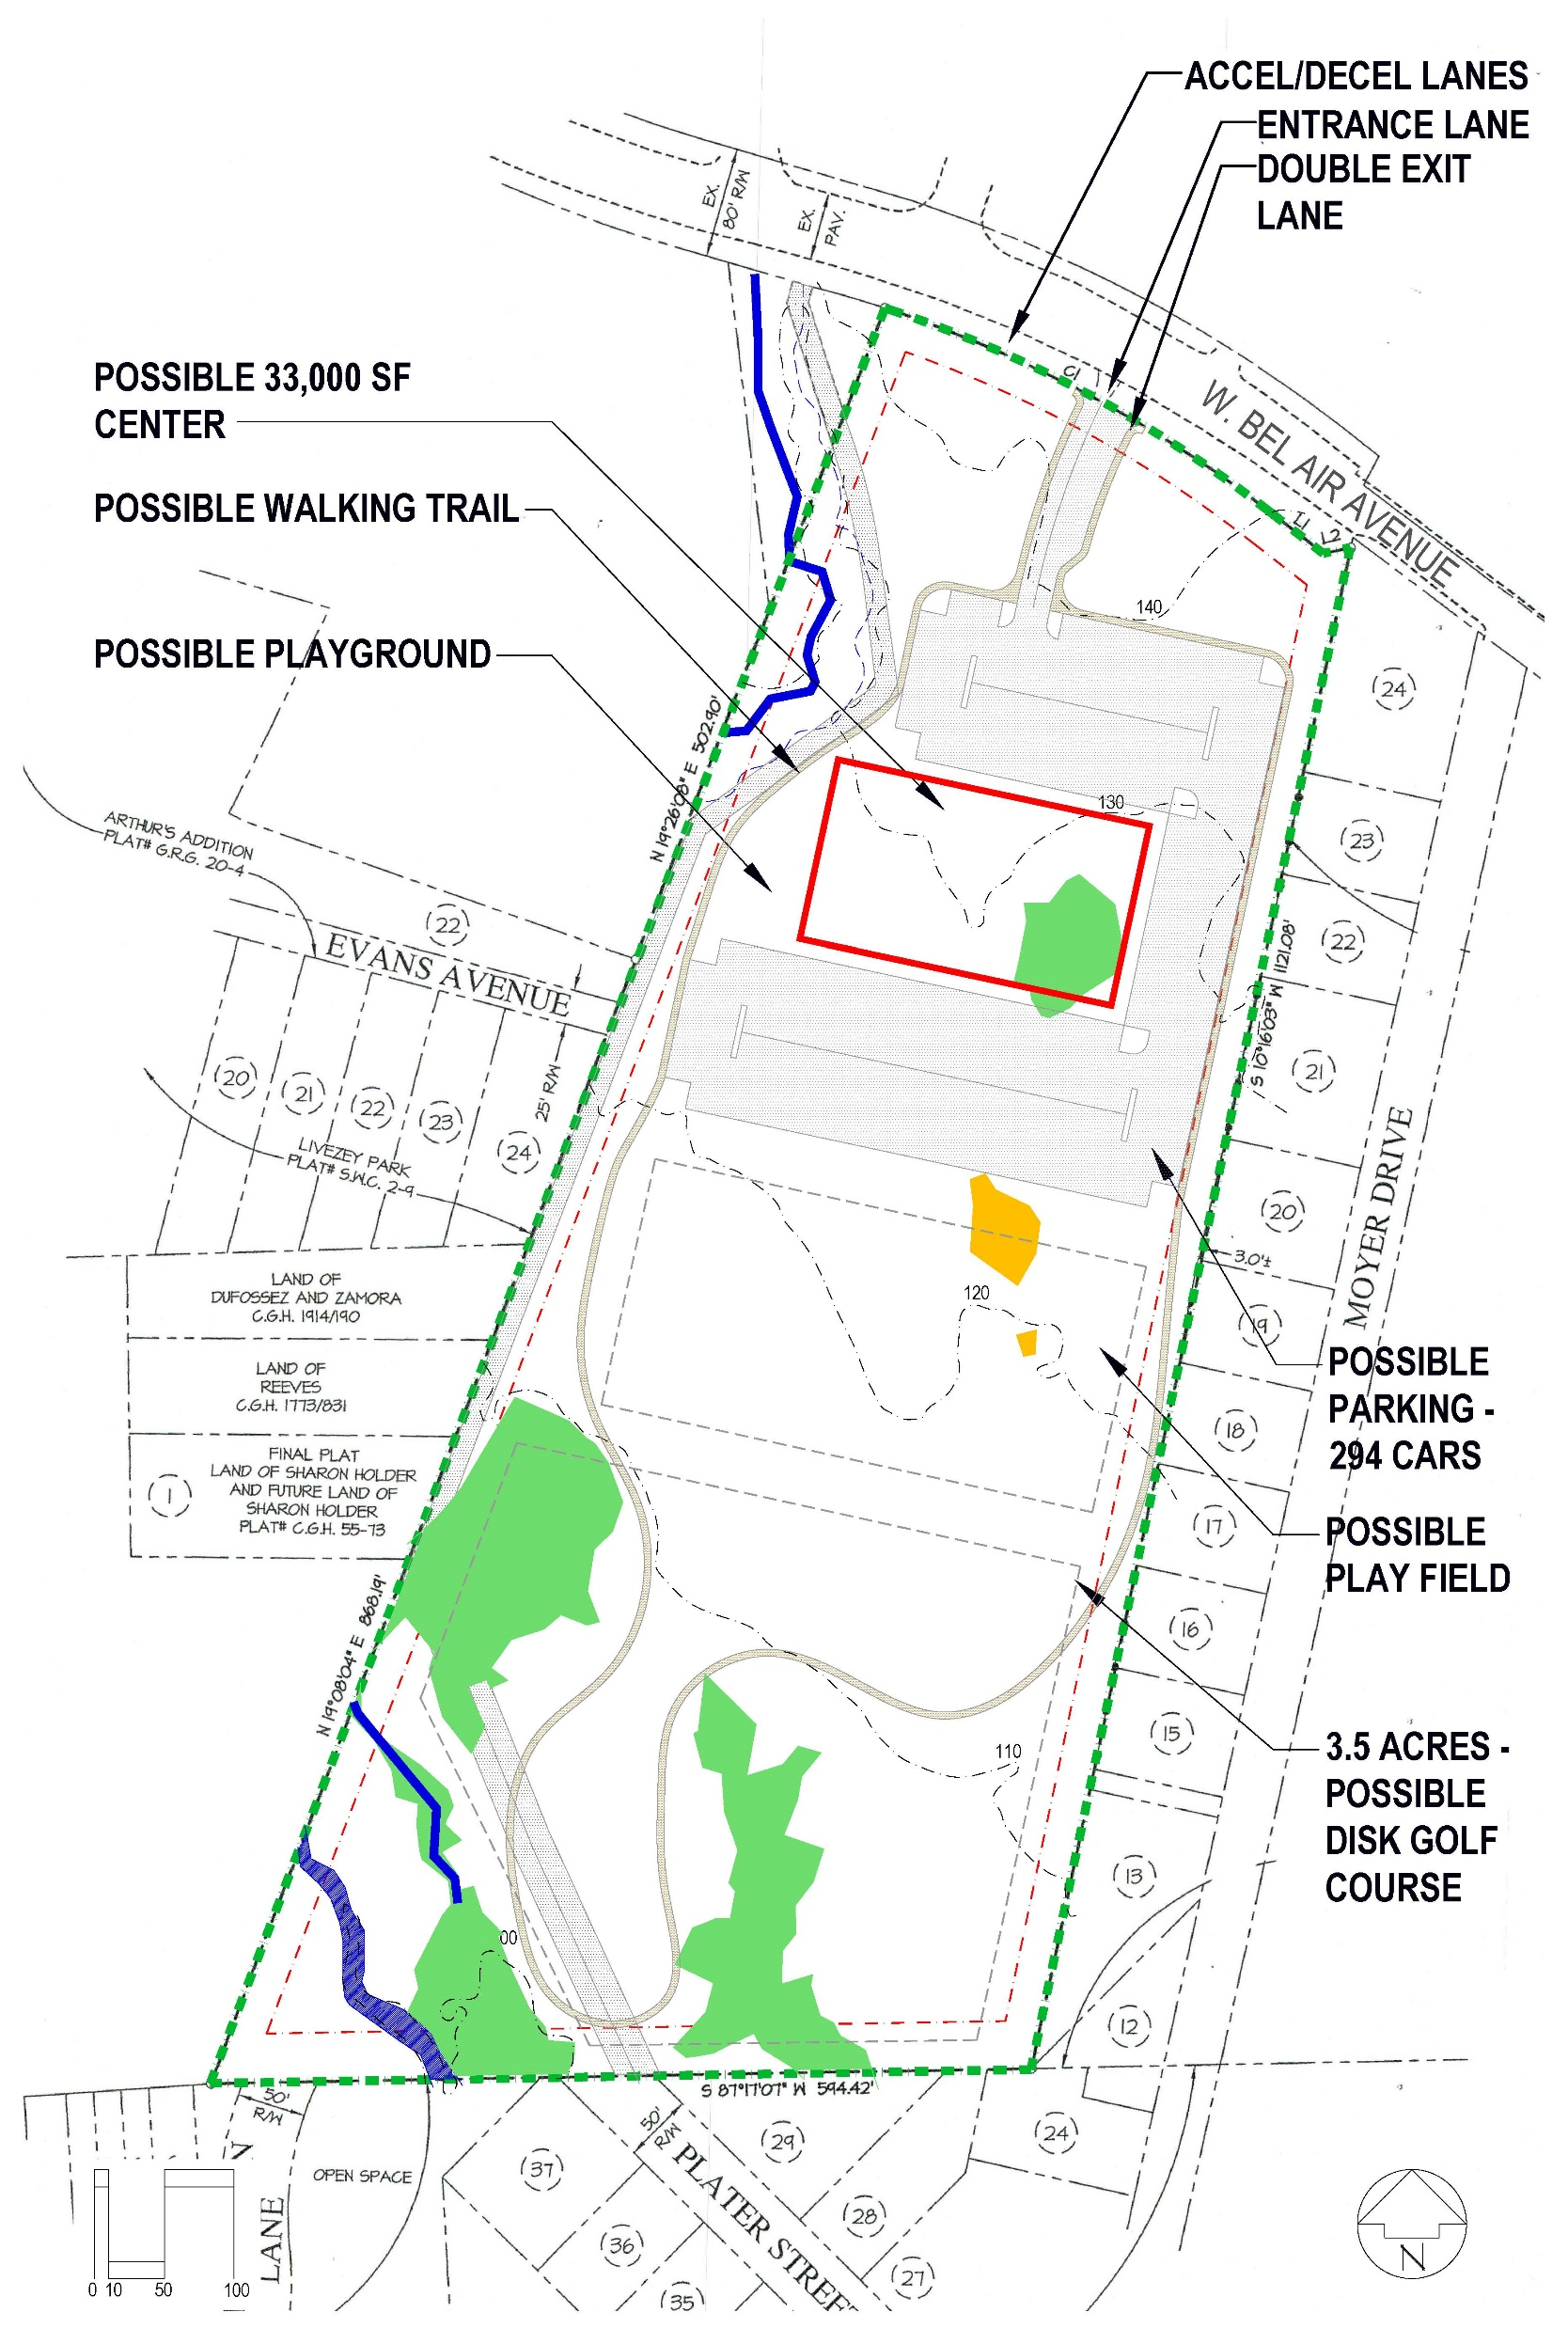
Site Possibilities
Possible Site Development
32,000 Square Foot Building
294 Parking Spaces (107 Required)
Walking Trail
All Purpose Play Field
Possible Disk Golf Course
The amenities and their locations are shown to offer a “sense of scale” of how they could fit on the site.
More will be determined once an environmental survey is undertaken.
Community Meeting March 10, 2022

Slide 15
Next Steps
The following surveys and studies will be conducted to
determine their impact on the design of the building
and site:
Perform an environmental survey of the site
Perform a grading survey
Determine if a wetlands mitigation strategy is viable
Review any additional community input
Finalize spatial program
Community Meeting March 10, 2022

Slide 16
Questions?
Community Meeting March 10, 2022

